Slide 1
Home In Tacoma Project
Permit Advisory Group
May 17, 2023
Notes:
STEVE -
Want to be clear about the timing/sequencing (fact sheet coming soon)
In 2024 – new rules in place

Slide 2
Agenda
Review and discuss
Home In Tacoma – Phase 2 initial zoning and standards
2023 State Legislative Session and options for Home In Tacoma
Upcoming City Council District in-person meetings

Slide 3
Home in Tacoma as part of the Affordable Housing Action Strategy (AHAS)
AHAS Objectives
Objective 1: More homes for more people
Objective 2: Keep housing affordable and in good repair
Objective 3: Help people stay in their homes and communities
Objective 4: Reduce barriers for people who often encounter them
Home In Tacoma
Updating Tacoma’s housing rules to promote housing supply, choice and affordability
Residential zoning and standards
Affordable housing regulatory tools
Actions to support growth
Notes:
ELLIOTT –
Housing continues to be a top priority
We hear about housing needs regularly
Home In Tacoma – focuses on one very important part (our housing growth strategy)
But, does not stand alone (support for people experiencing house-lessness, renter assistance and protections, funding for affordable housing
Anti-displacement: Housing rules are very relevant

Slide 4
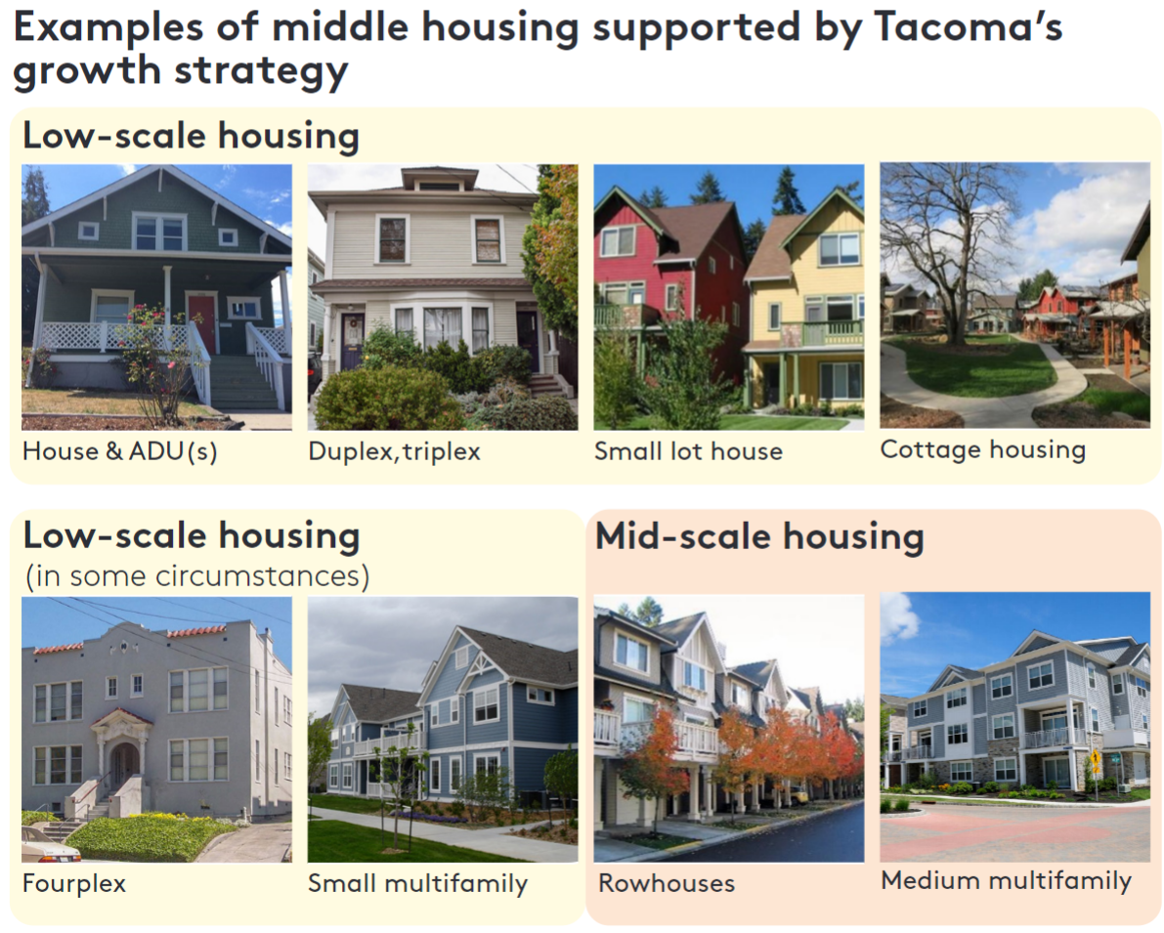
Home In Tacoma – Phase 1 Outcomes
Established a Middle Housing Growth Strategy
Comprehensive Plan goals and policies
Low-scale and Mid-scale Land Use Designations
Updated range of housing types and densities to be allowed in areas formerly designated for single-family detached
Direction
Expand tools to address affordability and anti-displacement
Evaluate public facility and service needs
Shift towards form-based codes
Notes:
ELLIOTT –
Very important to frame HIT Phase 2 in the context of what Council has already decided
“Not if we will support middle housing types, but how to get it right”
Council gave us a solid foundation with Phase 1
And, direction on what Phase 2 will accomplish (some specifics – MFTE, View study in East Tacoma…)

Slide 5
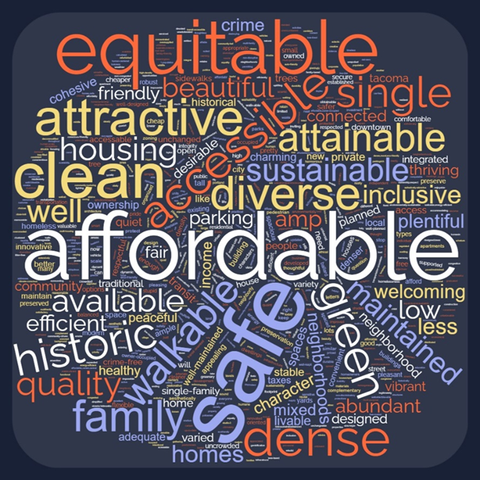
Engagement overview
Round 1: January to February
Housing equity champions: 24 participants
Environmental Impact Statement: ~100 comments
Home In Tacoma survey: ~1100 responses
Ideas wall: 100+ and growing
Developer engagement
Community events and meetings
Round 2: April to June
In-person City Council District meetings
Round 3: mid-2023
Planning Commission Public Hearing
cityoftacoma.org/homeintacoma

Slide 6
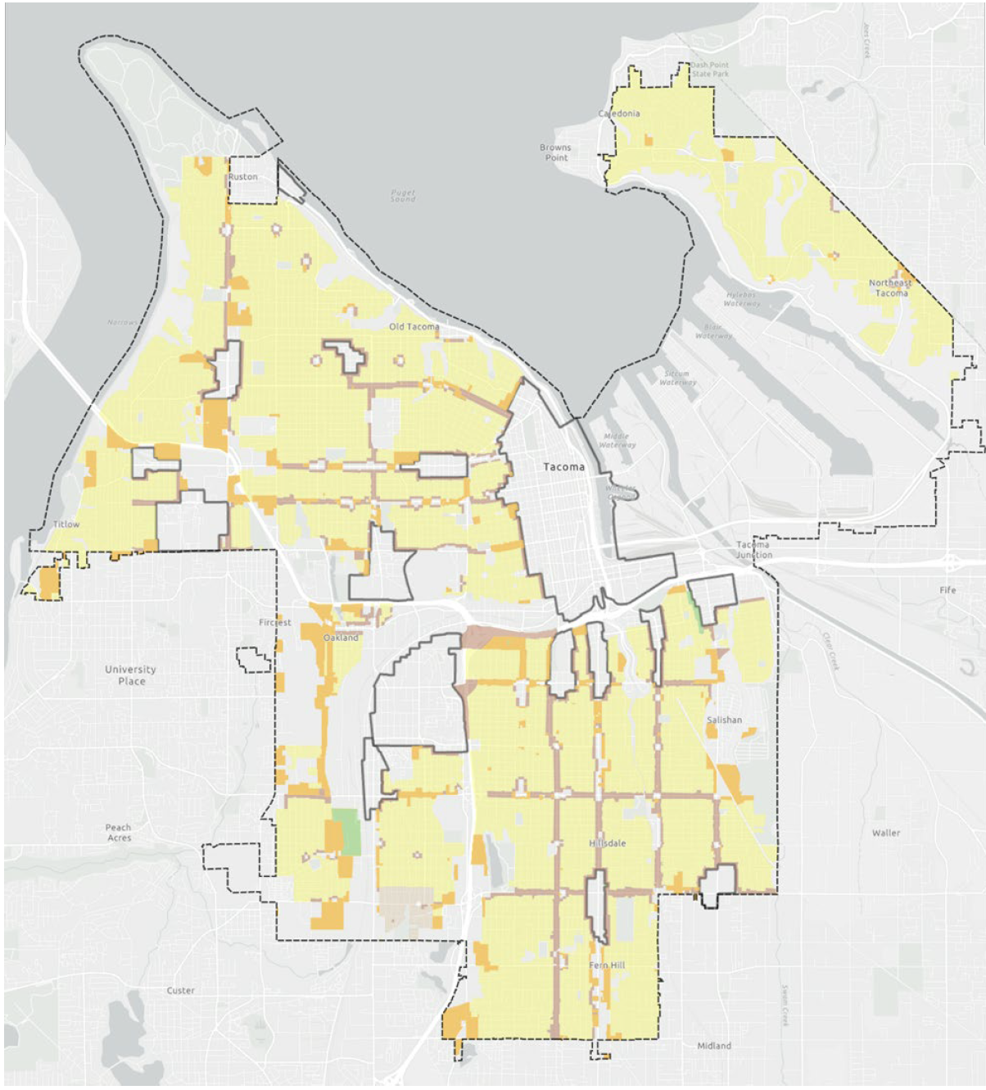
Initial package: Zoning
Adopted policy direction
Missing Middle Housing (citywide, systematic approach)
Low-scale and Mid-scale areas
Housing types, number of units
Initial proposals (highlights)
A “hybrid” form-based system
2 Low-scale zones and 1 Mid-scale zone
Higher density + scale through bonuses; near “complete neighborhood features”
Other areas (such as Parks and Open Space) zoned Low-scale; new Passive Open Space Overlay District
Notes:
Council gave strong foundation
Over the next couple of months, will focus on big picture: concepts for a zoning framework
At end of next round – a draft zoning map
Then – refinements, potential VSD expansion…
Ready for those neighborhood meetings

Slide 7
Initial package: Hybrid Zoning Framework
1. Unit Count
How many units can be accommodated on a specific site.
2. Scale
District-wide standards,
such as:
Height
Setbacks
3. Housing Types
Housing-type based standards, such as:
Building dimensional standards
Orientation
Access
Building design elements
Notes:
We talked about form-based approaches extensively
Shifting away from unit count/density as the primary way to organize our zoning code
Toward scale/housing types (both focus primarily on the form of the building)
The concept of housing types is new to our code – it’s a way to communicate more clearly on the desired form of the building and to accommodate specific design considerations (such as shared space)
In the PC’s initial recommendations, we will have components of all 3 – but the big move is that it’s no longer going to be based on 1 unit

Slide 8
Initial package: Housing Types
Small, detached building behind main structure (1 or 2 units)
A group of units arranged around a shared courtyard. Depending on the zone, could be attached
A single building with 1 to 6 units, generally the size and position of a single-family house
A medium building with multiple, stacked units, usually shared entrance
Attached units with access to the sidewalk, individual front features

Slide 9
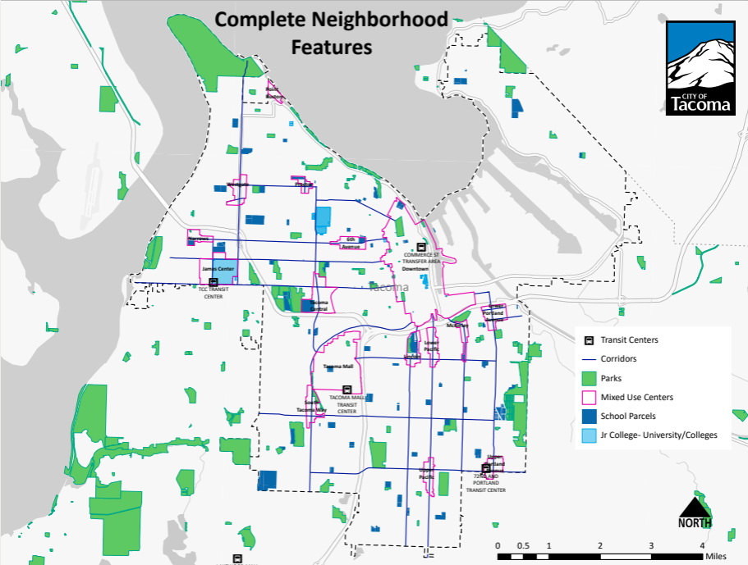
Initial package: Low-scale Zoning Districts
Low-scale Residential 1: 3 units (4 with bonuses) on a typical lot
Low-scale Residential 2: 4 units (6 with bonuses) on a typical lot – proposed for areas near “complete neighborhood” features
NOTE: New state requirements — generally, 4 dwellings (6 with bonus), 6 dwellings within ¼ mile of major transit
Notes:
The zoning map answers the question about the circumstances… Which do you think is right? What are the differences? Where should the City allow a little more density? POSTER OF THE CRITERIA with dots…

Slide 10
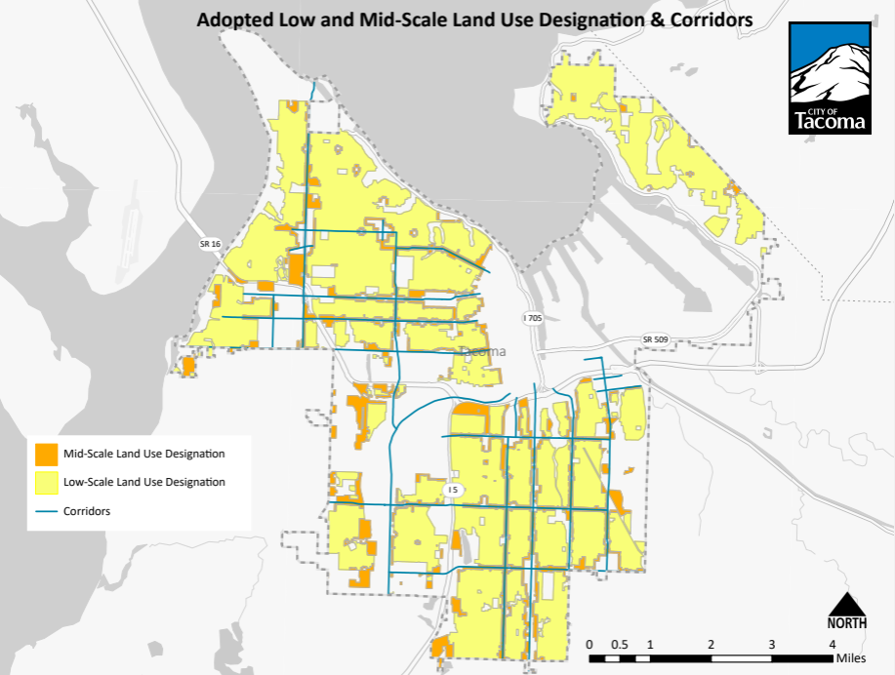
Initial package: Mid-scale Zoning District
Mid-scale Residential: 6 to 8 units on a typical lot; bonus to 4 stories
Bonus height near designated Corridors, where additional height will not be incompatible

Slide 11
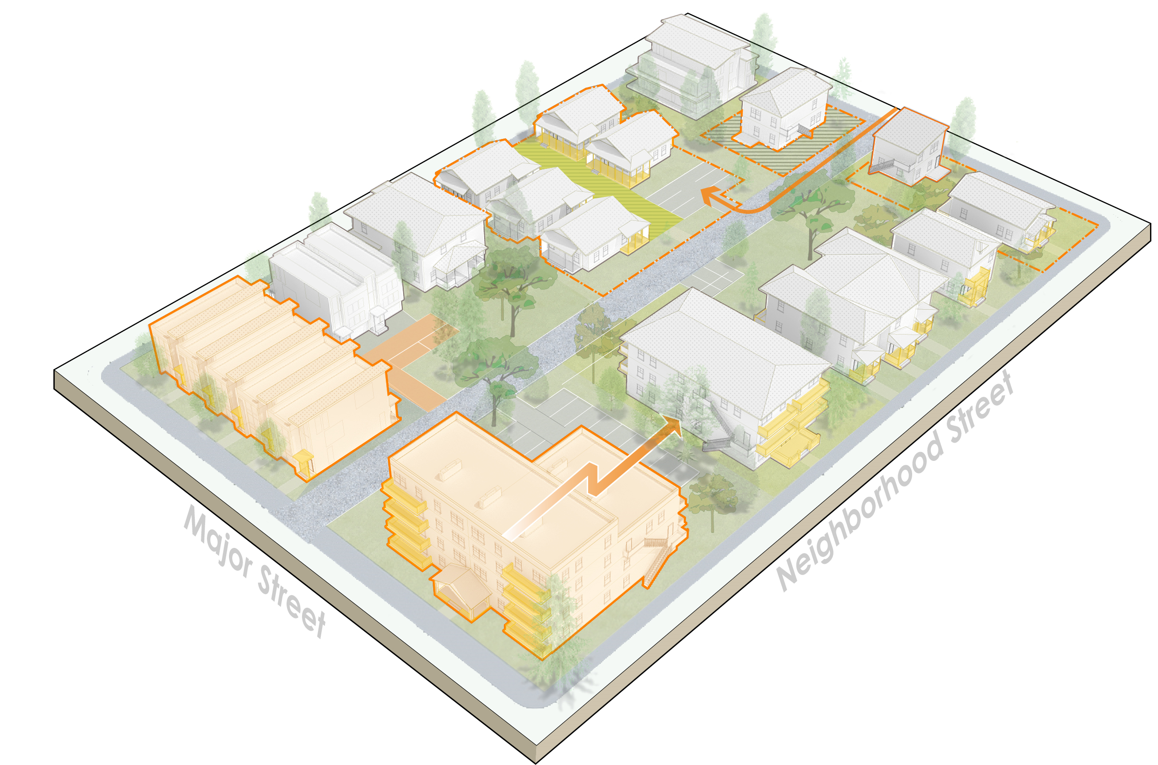
Initial package: Standards
Adopted policy direction
Support middle housing
Compatibility with residential patterns (such as building size, yards, access)
Meet multiple goals – affordability, choice, ownership, sustainability, accessibility, reuse and more
Initial proposals (highlights)
More flexibility (such as reduced lot size, setbacks, parking requirements)
Prioritize compatibility (such as building scale, housing type standards, trees, yard standards)
NOTE: New state requirements (ex: parking requirements capped near major transit)
Notes:
Phase 1 direction
About priorities; balance….
Over the next couple of months-
Establish the big moves (such as – are we increasing tree requirements?; options to encourage reusing existing buildings? How big will new buildings be?)
There will be tradeoffs with housing development and cost
By the Mar-April neighborhood meetings will have a package to react to

Slide 12
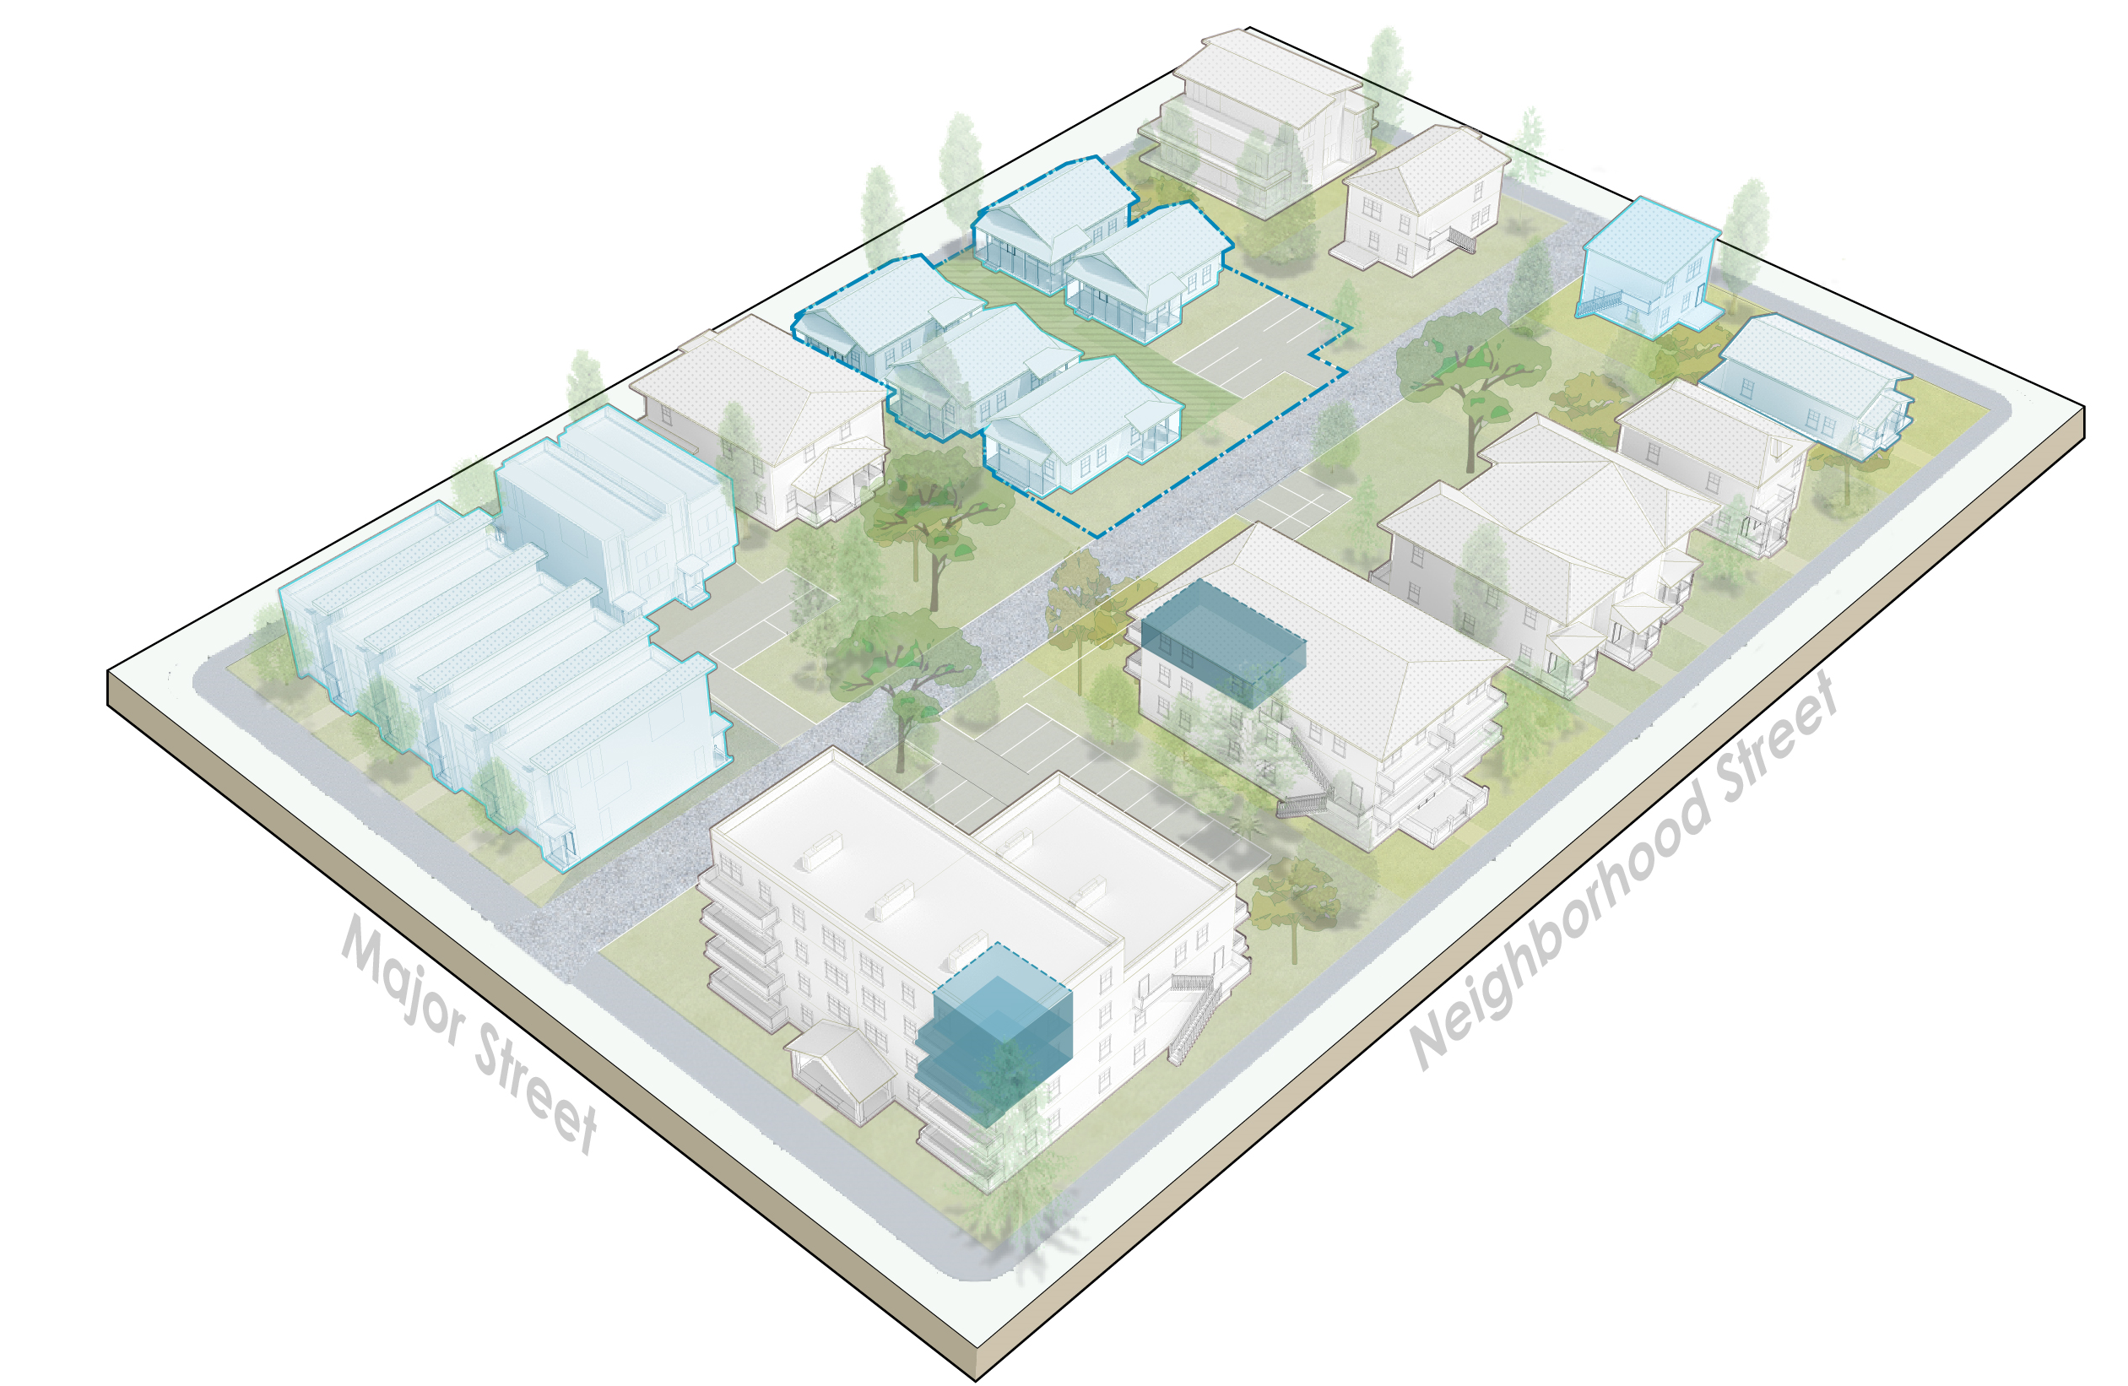
Initial package: Affordability and Anti-displacement
Adopted policy direction
Calibrate standards to promote affordability
Strengthen regulatory affordable tools
Expand Multifamily Tax Exemption Program
Coordinated anti-displacement strategy
Initial proposals (highlights)
Get the costs/benefits right
Affordability is top priority, other public benefits could be considered
Density + building scale is most valuable as bonus
NOTE: New state requirements (bonus from 4 to 6 with 2 affordable units)
Notes:
Phase 1 direction
How we write housing rules matters for how much housing gets built and affordability
Middle housing is important – but there will remain unmet need for affordable housing
Ownership opportunities
Decisions:
Over next couple of months – gathering input on tradeoffs (both for standards AND for specific affordability tools); using that to come up with big moves
One basic concept – incentives need to be valuable to developers (often that means allowing bigger buildings/more units)
By March-April:
At neighborhood meetings, share how those could play out
Refinements to the proposals

Slide 13
State housing-related bills and HIT
 | Home In Tacoma | State bills
Density | Low-scale 1: 3 units (4 with bonus) Low-scale 2: 4 units (6 with bonus) | 4 units (6 with bonus)
Density bonuses | Affordability, proximity to Centers, parks, schools, etc. | Affordability, proximity to “major transit stops”
Parking | Reducing, but not yet defined | No parking requirements within ½ mile of major transit stops
ADUs (height) | Current is 20 feet, exploring more | Must be at least 24 feet
SEPA Exemptions | EIS in process | Need to ensure EIS review meets state-required criteria (i.e. WSDOT review)

Slide 14
Home In Tacoma Open House Events
Learn about Home In Tacoma and share your views on how to get middle housing right
District 1: Wednesday, June 7th at Tacoma Public Library Swasey Branch (7001 6th Ave)
District 2: Thursday, May 25th at Meeker Middle School (4402 Nassau Ave NE)
District 3: Thursday, June 1st at Tacoma Community House (1314 S L St.)
District 4: Monday, May 22nd at Stewart Middle School (5010 Pacific Ave)
District 5: Thursday, June 8th at Tacoma Public Library Fern Hill Branch (765 S 84th St.)
Virtual Meeting: Wednesday, June 14th on Zoom
Meetings are 6-8 p.m. and are free and open to all!

Slide 15
Discussion
Home In Tacoma – initial package
State housing bills and options for Home In Tacoma
Upcoming Council District meetings

